Slide 1
Computer Network
Unit -1
Introduction To Computer Network
Prepared by: Er. Abita Kunwar

Slide 2



Computer Network (Definition):
A set of interconnected computers and other computing hardware devices which are linked together through communication channels (such as wired or wireless media) to facilitate the exchange of data, sharing of resources and communication between devices.
The main purpose of a computer network is to exchange resources and services among wide range of users.
Understanding Network Connectivity and Communication
Interconnected Devices
A computer network consists
of multiple computing devices
linked via wired or wireless
communication
Data Exchange & Resource
Sharing
Facilitates the seamless exchange
of data and shared access to
resources like printers and
databases.
Purpose & Functionality
Enhances communication, enables
collaboration, and improves
efficiency in businesses and
organizations.

Slide 3
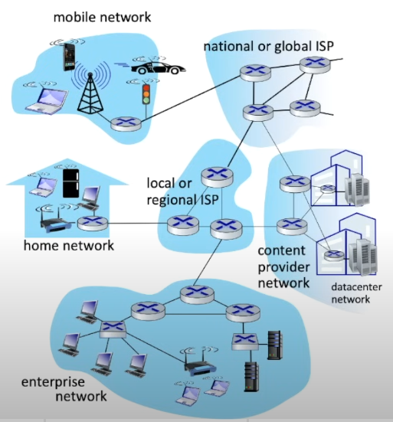

Slide 4
Uses of Computer Network:
Business application
  Resource sharing. Ex: Printer
  Server-Client model
  Communication medium E-commerce
Home applications
  Access to remote information
  Person-to-Person communication
  Interactive entertainment
  Electronic commerce: B2C, B2B, P2P

Slide 5
Uses of Computer Network:
Used by mobile users for various communication as well as entertainment purpose like email, video meetings, Netflix, Youtube etc.

Slide 6
Advantage/Benefits
It offers convenient resource sharing
It is highly flexible and it is inexpensive
It increases the storage capacity
It makes file sharing easier
It enhances communication

Slide 7
Disadvantages:
Comes with the risk of security issues
Encourages people to become dependent on computers
High chance of computer viruses and malware
If the main server of the network is down, the entire system becomes useless
Requires an efficient handler

Slide 8
Network as an infrastructure for data communication.
Data communication refers to the exchange of data between a source and a receiver via the form of transmission media such as a wire cable.
For data communications to occur, the communicating devices must be part of a communication system made up of a combination of hardware (physical equipment) and software (programs).
Data communications refers to the transmission of digital data between two or more computers
The communication system that consists of the interconnection between two or more devices is referred to as a Network.
A network is a set of devices (often referred to as nodes) connected by communication links. A node can be a computer, printer, or any other device capable of sending and/or receiving data generated by other nodes on the network.

Slide 9
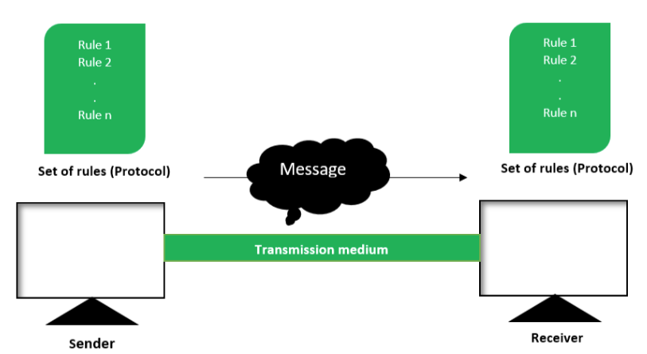
Basic Communication Model:
Fig: Data communication model

Slide 10
Components of data communications system:
Message: The message is the information (data) to be communicated. Popular forms of information include text, numbers, pictures, audio, and video.
Sender: The sender is the device that sends the data message. It can be a computer, workstation, telephone handset, video camera, and so on.
Receiver: The receiver is the device that receives the message. It can be a computer, workstation, telephone handset, television, and so on.
Transmission medium: The transmission medium is the physical path by which a message travels from sender to receiver. Some examples of transmission media include twisted-pair wire, coaxial cable, fiber-optic cable, and radio waves.
Protocol: A protocol is a set of rules that govern data communications. It represents an agreement between the communicating devices.

Slide 11
Characteristics of Data Communication System:
The effectiveness of a data communications system depends on four fundamental characteristics: delivery, accuracy, timeliness, and jitter.
Delivery: The system must deliver data to the correct destination. Data must be received by the intended device or user and only by that device or user.
Accuracy: The system must deliver the data accurately. Data that have been altered in transmission and left uncorrected are unusable.
Timeliness: The system must deliver data promptly. Data delivered late are useless. In the case of video and audio, timely delivery means delivering data as they are produced, in the same order that they are produced, and without significant delay. This kind of delivery is called real-time transmission.
Jitter: Jitter refers to the variation in the packet arrival time. It is the uneven delay in the delivery of audio or video packets.

Slide 12
Components of Network Infrastructure
Hardware
  End devices: Computers, smartphones, servers, and IoT devices that generate or consume data
  Networking devices: Routers, switches, hubs, access points (AP’s) that manage and direct data flow
  Transmission Media: Wired (e.g., Ethernet cables, Fiber optics) or wireless (e.g., radio waves, satellite) channels used for data transmission

Slide 13
Components of Network Infrastructure
Software
  Operating System: Manage device functionality and provide network support(eg: Windows Server, Linux)
  Applications: Enable communication services like email, video conferencing and flie sharing
  Management Tools: Monitor and configure network performance(eg: SNMP tools).

Slide 14
Components of Network Infrastructure
Protocols
  Communication Protocols: Standardized rules for date exchange, such as TCP/IP, HTTP, FTP and DNS
  Security Protocols: Secure data transmission, including SSL/TLS, Ipsec, and WPA

Slide 15
Application Of Computer Network
Computer networks are widely used in various fields and industries to facilitate communication, data sharing, resource sharing, and much more. Below are some of the primary applications of computer networks:
Communication:
Computer networks facilitate various forms of communication, making it faster and more efficient.
Examples:
  Email: Sending and receiving messages electronically.
  Instant Messaging: Real-time text communication (e.g., WhatsApp, Slack).
  Video Conferencing: Virtual meetings (e.g., Zoom, Microsoft Teams).
  Voice over IP (VoIP): Making phone calls over the internet (e.g., Skype, WhatsApp Calls).

Slide 16
Application Of Computer Network
Resource Sharing:
Networks allow multiple users to share hardware, software, and data resources.
Examples:
  Shared Printers: Multiple users can access a single printer over a network.
  File Sharing: Sharing files and documents across devices (e.g., Google Drive, Dropbox).
  Shared Databases: Centralized databases accessible to multiple users (e.g., company CRM systems).

Slide 17
Application Of Computer Network
Internet Access:
Computer networks provide access to the internet, enabling users to browse websites, stream media, and access online services.
Example:
  World Wide Web (WWW): The internet itself is a computer network that provides access to the World Wide Web, where users can browse websites, interact with content, and access information from anywhere in the world.
  Web Hosting: Websites are hosted on servers that are part of a network, enabling users to access the information online. Services like Amazon Web Services (AWS), Google Cloud provide web hosting services.
  Cloud Computing: Cloud platforms like Google Cloud, AWS, and Microsoft Azure enable businesses and individuals to store data, run applications, and access computing resources without owning physical hardware.

Slide 18
Application Of Computer Network
E-Commerce:
Networks enable online buying and selling of goods and services.
Examples:
  Online Shopping: Platforms like Amazon, eBay, and Alibaba.
  Digital Payments: Services like PayPal, Stripe, and mobile payment apps.
  Banking: Online banking and financial transactions.

Slide 19
Application Of Computer Network
Education and E-Learning:
Networks support online education and remote learning.
Examples:
  Online Courses: Platforms like Coursera, Udemy.
  Virtual Classrooms: Tools like Google Classroom and Zoom for remote teaching.
  Research Collaboration: Sharing resources and collaborating on academic projects.

Slide 20
Network Types (On the Basis Of Size)
Personal Area Network(PAN)
Local Area Network(LAN)
Campus Area Network(CAN)
Metropolitan Area Network(MAN)
Wide Area Network(WAN)

Slide 21
Personal Area Network(PAN):
It is the smallest type of network, covering a small geographic area—usually within a range of about 10 meters (33 feet).
It typically involves a few devices such as smartphones, tablets, laptops, printers, and other personal electronic devices that are connected wirelessly or through short-range wired connections.
These devices are typically used by a single person, and the network might be managed by them.
PANs are most commonly found in homes or small offices.

Slide 22
Local Area Network(LAN):
It is a computer network that spans a relatively small geographical area, such as a home, office building, or a campus.
LANs typically cover areas ranging from a few meters to a few kilometers, depending on the type of network and the technology used.
It is typically used to connect computers, devices, and shared resources like printers, servers, and storage devices within a limited area.
LANs are often used for resource sharing, including files, printers, and internet connections.
LANs can be set up using various topologies, such as bus, star, ring, or tree configurations, although modern LANs primarily use the star topology with Ethernet and Wi-Fi connections.

Slide 23
Wireless Local Area Network(WLAN)
It is a type of LAN that uses wireless communication methods, such as Wi-Fi, to connect devices like computers, smartphones, printers, and other networked devices without the need for physical cables.
WLANs are used to provide internet access, resource sharing, and communication between devices within a specific geographic area.
Range: WLANs typically cover areas ranging from about 30 meters (98 feet) to 100 meters (328 feet) indoors, depending on factors like the router's power, obstacles (walls, furniture), and the Wi-Fi standard (e.g., Wi-Fi 4, 5, or 6).
In outdoor or open areas, the range can extend up to several hundred meters, but performance can be affected by interference and obstructions.

Slide 24
Campus Area Network(CAN)
It is a computer network that spans a limited geographical area, such as a university campus, large K-12 school district, or a small business complex.
CANs typically connect multiple buildings or locations that are in close proximity to one another, enabling users within the network to share resources like files, printers, and servers.
These networks are often used by institutions or organizations to facilitate communication and resource sharing between different departments or areas within a campus-like setting.

Slide 25
Metropolitan Area Netowork(MAN)
It is made up of interconnection of LANs in a geographical area or region as large as town or a small neighbourhood within a metropolitan area.
It is larger than CAN and smaller than WAN.
They are used to establish connection between buildings of a town, or universities, distribution of wireless routers across a city, cable TV, fiber connections and so on.
It can also connect traffic lights and parking meters wirelessly as a part of smart city infrastructure. Generally covers towns and cities up to 50 km in range

Slide 26
Wide Area Network
It spans a large geographical area, such as a state, region, or country.
It is used to connect multiple Local Area Networks (LANs) or Metropolitan Area Networks (MANs) that are far apart. WANs enable communication over long distances, allowing computers and other devices to connect remotely.
Since WANs cover extensive areas, their communication infrastructure is more complex than that of a LAN.
The internet is the largest and most common example of a WAN, as it interconnects computers and networks worldwide.

Slide 27
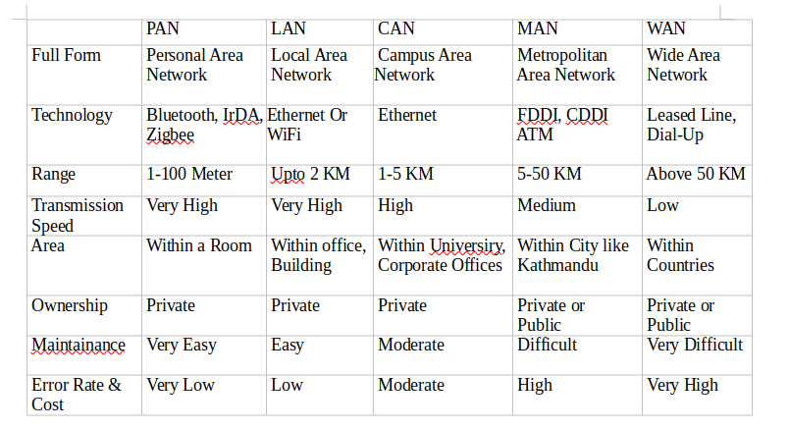
Comparison Of Network Types:

Slide 28
Network Architecture:
Peer-To-Peer Architecture(P2P)
Client/Server Architecture
Cloud-Based

Slide 29
Client-Server Architecture
It is a computing model in which the server hosts, delivers and manages most of the resources and services to be consumed by the client.
This type of architecture has one or more client computers connected to a central server over a network or internet connection.
This architecture is also known as a networking computing model because all the requests and services are delivered over a network.

Slide 30
Client-Server Architecture
Client server architecture is a producer/consumer computing architecture where the server acts as the producer and the client as a consumer.
A server computer can manage several clients simultaneously, where as one can be connected to several servers at a time, each providing a different set of services

Slide 31
Client-Server
Advantages:
Centralized control and security
Easy to manage large networks
Reliable data backup and recovery
Disadvantages:
Expensive setup and maintenance
Server failure can disrupt the entire network

Slide 32
Peer-To-Peer
Peer-to-Peer (P2P) network is a type of network architecture where each computer (node) acts as both a client and a server, sharing files and resources directly with other nodes without relying on a centralized server.
In a P2P network:
Each computer can store and share files independently.
It is commonly used in home or office networks for direct file sharing.
When expanded over the internet, P2P networks enable large-scale data sharing across multiple users.
Examples: BitTorrent, blockchain networks (like Bitcoin), and VoIP applications (like Skype).
While P2P networks are sometimes associated with illegal file sharing, they also have legitimate uses, such as decentralized computing, data distribution, and secure transactions.

Slide 33
Peer-to-Peer
Advantages:
Cost-effective (no need for a central server)
Easy to set up and scale
Efficient resource sharing
Disadvantages:
Less security and control
Difficult to manage in large networks

Slide 34
Cloud-Based
A Cloud-Based Architecture is a network computing model where computing resources, applications, and data storage are hosted on remote cloud servers and accessed via the internet instead of being stored on local machines.
In this model:
Cloud service providers (e.g., AWS, Google Cloud, Microsoft Azure) manage infrastructure, security, and maintenance.
Users can access computing power, storage, and applications on-demand, without needing physical hardware.
It is widely used for web applications, data storage, artificial intelligence, and enterprise solutions.

Slide 35
Cloud-Based
Types of Cloud-Based Architecture
Public Cloud – Services are shared and hosted by third-party providers (e.g., Google Drive, Dropbox).
Private Cloud – Dedicated cloud resources for a single organization (e.g., corporate data centers).
Hybrid Cloud – A mix of public and private clouds for flexibility (e.g., enterprise solutions).
Multi-Cloud – Using multiple cloud providers to prevent dependency on one provider.

Slide 36
Cloud-Based
Advantages:
Scalable and flexible
Accessible from anywhere
Cost-effective for businesses
Disadvantages:
Internet dependency
Security concerns with data privacy

Slide 37
Hybrid Architecture
A combination of client-server and P2P architectures.
Some services are provided by centralized servers, while certain data or resources are shared directly between peers.
Common in modern enterprise networks and cloud computing.
Example: Businesses that use local servers for sensitive data and cloud storage for backup.

Slide 38
Hybrid-Alternate
A Hybrid Architecture is a network computing model that combines multiple architectures, such as Client-Server, Peer-to-Peer (P2P), and Cloud-Based systems, to enhance flexibility, scalability, and performance.
In this model:
Some data and applications are hosted on local servers (private cloud) for security.
Other services are provided through public cloud providers (e.g., AWS, Google Cloud).
It allows businesses to balance cost, performance, and security by using different architectures for different needs.

Slide 39
Hybrid
Advantages:
✔ Combines the best features of both architectures
✔ Improves performance and reliability
✔ More control over security
Disadvantages:
✘ Complex to set up and maintain
✘ Can be costly

Slide 40
Network Protocols
A set of rules and standards that govern data transmission between devices in a network.
Ensure seamless communication between devices, regardless of their hardware, software, or internal processes.
Essential for global digital communication, enabling internet, emails, video calls, and file sharing.

Slide 41
Network PROTOCOL
Importance of Network Protocols:
Enable Communication – Facilitate smooth data exchange between devices.
Ensure Compatibility – Allow different hardware and software to interact.
Standardize Data Transmission – Prevent miscommunication and errors.
Improve Security – Protect data using encryption and authentication (e.g., HTTPS, SSL/TLS).
Support Network Management – Help monitor and manage networks (e.g., DHCP, SNMP).

Slide 42
Network Protocols
1. HTTP is a set of rules that lets your browser and web server communicate, ensuring websites load correctly.
2. Secure Shell or Secure Socket Shell SSH is a network protocol that gives users -- particularly systems administrators -- a secure way to access a computer over an unsecured network.
3. The SMS protocol is a set of standardized rules for transmitting short text messages (up to 160 characters) between mobile devices via cellular networks, using a store-and-forward mechanism

Slide 43
Key Elements of Network Protocol
1. Syntax (Data Format & Structure)
Defines the structure and organization of data.
Specifies how data is formatted before transmission.
Example: HTTP requests must follow a specific format (headers, body, etc.).

Slide 44
Key Elements of Network Protocol
2. Semantics (Meaning of Data)
Defines the rules for interpreting transmitted data.
Determines how devices should process and respond to messages.
Example: TCP ensures data packets are received in order and reassembled correctly.

Slide 45
Key Elements of Network Protocol
3. Timing (Synchronization & Speed Control)
Manages synchronization between sender and receiver.
Controls the speed of data transmission to avoid congestion.
Example: Flow Control in TCP prevents data loss due to network overload.

Slide 46
Key Elements Of Network Protocol
4. Error Handling & Detection
Identifies and corrects errors during data transmission.
Ensures data integrity and prevents corruption.
Example: Checksum in TCP/IP detects transmission errors.

Slide 47
Key Elements Of Network Protocol:
5.Addressing & Routing
Defines how devices are identified and located in a network.
Ensures data is sent to the correct destination.
Example: IP Addressing (IPv4/IPv6) is used to identify devices on the internet.

Slide 48
Key Elements of Network Protocol:
6. Security & Authentication
Protects data from unauthorized access, modification, or interception.
Ensures that only authenticated devices can communicate.
Example: SSL/TLS encrypts HTTPS connections for secure web browsing.

Slide 49
Network Topology:
Network topology refers to the physical or logical layout of a network.
How the data is transferred between these nodes.
Network topology refers to the physical or logical layout of a network, defining how different nodes (computers, switches, routers, etc.) are connected and how they communicate.
It may also describe the data transfer methods between nodes in the network.

Slide 50
Network Topology:
Network topology is the schematic description of a network’s structure, showing how various nodes (such as senders and receivers) are connected through communication links.
There are two ways of defining network topology geometry:
Physical network topology – The actual physical layout of devices and cables.
Logical network topology – The way data flows between network nodes.

Slide 51
Types Of Network Topology:
The six types of network topologies are as follows:
Bus Topology
Star Topology
Ring Topology
Mesh Topology
Tree (Hierarchical) Topology
Hybrid Topology

Slide 52
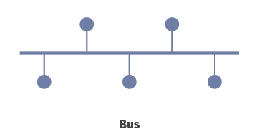
Bus Topology:
Bus Topology is a network type in which every computer and network device is connected to single cable.
The cable to which the nodes connect is called a “backbone”.
If the backbone is broken, the entire segment fails.

Slide 53
Bus Topology:
In this topology, all nodes share a common transmission medium for data communication.
Data is transmitted over this medium and can be received by all nodes simultaneously.
When an electrical signal reaches the end of the bus, it can be reflected back, causing unwanted interference.
To prevent signal reflection, both ends of the bus are terminated with a terminator.
A terminator contains a resistor that absorbs the signal, ensuring smooth data transmission.

Slide 54
Features Of Bus Topology:
Every device is connected to a single cable.
The bus topology has all its nodes connected directly to a link and has no other connection between nodes.
There is no signal generation on each node or router

Slide 55
Advantages
Simple and cost-effective.
Requires less cabling than other topologies.
Easy to install and expand.
Works well for small networks.
Suitable for temporary networks.

Slide 56
Disadvantages:
A single cable failure can take down the entire network.
Performance degrades with increased traffic.
Difficult to troubleshoot cable faults.
Limited scalability; not ideal for large networks.
Security risks, as data is transmitted across a shared communication line.

Slide 57
Star Topology:
All the computers/devices are connected to a central device(hub,switch, router, server).
Each device requires a single cable.
Point-to-Point connection between the device and central hub.
Most widely implemented.
Central Device(Hub/Switch) is the single point of failure

Slide 58
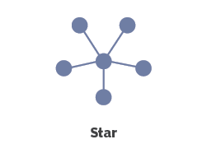
Star Topology:
Figure of Star Topology:

Slide 59
Features Of Star Topology:
Every node has its own dedicated connection to the hub.
Hub acts as a repeater for data flow.
Can be used with twisted pair, Optical Fiber or coaxial cable.

Slide 60
Advantages of Star Topology:
Fast performance with few nodes and low network traffic.
Central Device can be upgraded easily.
Easy to troubleshoot.
Easy to setup and modify.
If one computer on the network fails, the rest of the network continues to function normally.

Slide 61
Disadvantages Of Star Topology:
Cost of installation central device(hub, switch, router, server) is high therefore expensive to use.
If the central device fails then the whole network is stopped because all the nodes depend on it.
The central device determines the performance and the number of nodes the network can handle.

Slide 62
Ring Topology:
In a ring topology, each device is connected to two others, forming a circle. The last device connects back to the first, allowing data to travel around the network until it reaches its destination.
In Ring Topology,data can travel in one of two ways:
1. Unidirectional
2. Bidirectional

Slide 63
Ring Topology:
Unidirectional: All traffic moves in a single direction, either clockwise or anticlockwise around the ring.
Bidirectional: Data can travel in both directions around the ring, allowing more flexibility and fault tolerance.
Each device on the ring topology acts as a repeater to keep the signal strong as it travels.
Every node is a critical link.

Slide 64
Ring Topology:
Each device incorporates a receiver for the incoming signal and a transmitter to send the data on to the next device.
When a device sends data, it must travel through each device on the ring until it reaches its destination.
Data is transferred sequentially in a ring topology, bit by bit.
The data packet travels through each node (device) in the network until it reaches the intended destination. Every node plays the role of a repeater, amplifying and passing the signal forward.

Slide 65
Features Of Ring Topology:
In large ring topology networks, repeaters are used to amplify or regenerate signals over long distances. This ensures that data can travel without degradation, maintaining reliable communication across the entire network.
The transmission is unidirectional, but it can be made bidirectional by having 2 connections between each Network Node, it is call Dual Ring Topology.

Slide 66
Dual Ring Topology:
Dual ring topology consists of two concentric or parallel ring networks.
These rings typically carry data in opposite directions (clockwise and counterclockwise), providing redundancy and fault tolerance.
If one ring fails, the other can take over to ensure the network remains operational. This feature makes dual ring topology resilient to single-point failures.

Slide 67
Advantages of Ring Topology:
All data flows in one direction, reducing the chance of packet collisions.
Data can transfer between workstations at high speeds.
Cheap to install and expand.
Troubleshooting in ring network is much easier because cable fault can be easily located.
Ring Topology provides good communication over a long distance

Slide 68
Disadvantages of Ring Topology:
Since all data must pass through each workstation (node) in the network, the transfer speed can decrease as the number of nodes increases.
Adding or removing workstations temporarily disrupts the entire network, as the ring must be reconfigured.
Failure of one node or connection in a basic ring topology disrupts the entire network unless fault-tolerant mechanisms are implemented.
The hardware(such as Repeater) needed to connect each workstation to the network is more expensive than Ethernet cards and hubs/switches.

Slide 69
Mesh Topology:
In Mesh Topology, each node is connected to every other node in the network via a direct point-to-point connection.
All nodes are directly connected to each other, ensuring high redundancy and reliability.

Slide 70
Mesh Topology:
1. Routing: The data follows a specific path determined by a routing algorithm.
2. Flooding: The data is sent to all nodes within the network. Flooding doesn’t require any form of routing logic to work.

Slide 71
Types Of Mesh Topology:
There are two types of Mesh Topology:
1. Partial Mesh Topology.
2. Full Mesh Topology.

Slide 72
Types of Mesh Topology:
1. Partial Mesh Topology:
In this topology, only some nodes are fully interconnected, while others are connected to only a few nodes.
This approach reduces costs and complexity while still providing some level of redundancy.

Slide 73
Types Of Mesh Topology:
2. Full Mesh Topology:
In this topology, every node is directly connected to every other node in the network.
This setup offers maximum redundancy and fault tolerance but is more expensive and complex to implement.

Slide 74
Features Of Mesh Topology:
Fully Connected: Every node is directly linked to other nodes (in full mesh).
Robust: High fault tolerance due to multiple data paths.
High Redundancy: Ensures reliable communication but increases cost and complexity.

Slide 75
Advantages Of Mesh Topology:
No Traffic Congestion: There is no traffic problem as there are dedicated point to point links for each computer that can Tx/Rx simultaneously.
High Reliability with multiple paths: It has multiple links, so if one route is blocked then other can be accessed for data communication.
Enhanced privacy and security: It provides high privacy and security.
Easy fault identification and isolation: Fault identification is easy because of point-to-point connection.

Slide 76
Disadvantages of Mesh Topology:
Mesh Topology requires high no. of cables and I/O parts for the communication.
Installation is very difficult as each node is connected to every node.
It is costly compared to other network topologies.
The main disadvantages of a mesh are related to amount of cabling [n*(n-1)/2] and the number of I/O ports required.

Slide 77
Hybrid Topology:
A network structure whose design contains more than one topology is said to be hybrid topology.
It is a combination of two or more topology.
Flexible and reliable as error detection are easy to troubleshoot.
Scalable as size can be increased easily.

Slide 78
Advantages
This type of topology combines the benefits of different types of topologies in one topology.
Can be modified as per requirement.
It is extremely flexible

Slide 79
Disadvantages
It is a type of expensive network topology.
Design of a hybrid network is very complex.
Installation process is a difficult.

Slide 80
Choosing Topology
Current hardware
Size of the network
Budget limitations
Need for reliability
If network expansion is likely to be required.

Slide 81
The OSI Reference Model
ISO- International Organizations for Standard
OSI- Open Systems Interconnections
Developing in late 1970s
Approved by 1984
The term “Open” in Open System Interconnections denotes “to communicate with any 2 systems”
There are 7 layers in OSI Reference model

Slide 82
The OSI Reference Model
It is also called OSI layered architecture /OSI Protocol architecture
The process of breaking up the functions or tasks of networking into layers reduces complexity.
Each layer provides a service to the layer above it in the protocol specification.
Each layer communicates with the same layer’s software or hardware on other computers.
The lower 4 layers are concerned with the flow of data from end to end through the network
The upper Three layers of the OSI model are orientated more toward services to the applications

Slide 83
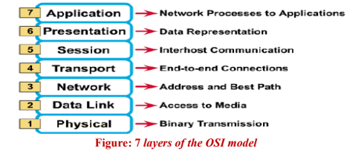
7 Layers Of OSI Model

Slide 84
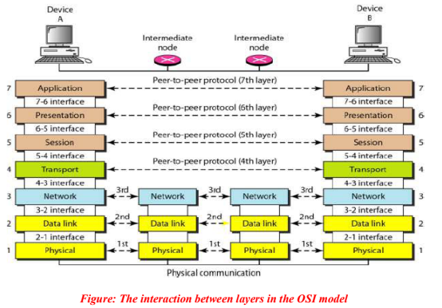
Interaction Between Layers Of OSI Model

Slide 85
OSI Model: Physical Layer
Physical Layer:
The physical layer coordinates the functions required to carry a bit stream over a physical medium.
It deals with the mechanical and electrical specifications of the interface and transmission medium.
It also defines the procedures and functions that physical devices and interfaces have to perform for transmission to occur.
The Physical Layer is hardware-oriented and focuses on the physical connection between devices.

Slide 86
OSI Model: Physical Layer
The physical layer is concerned with the following:
1. Physical characteristics of the medium
Physical characteristics of interfaces and medium. The physical layer defines the characteristics of the interface between the devices and the transmission medium. It also defines the type of transmission medium.
2. Representation of bits.
The physical layer data consists of a stream of bits (sequence of Os or
1s) . The physical layer defines the type of encoding(how Os and Is are changed to signals).

Slide 87
OSI Model: Physical Layer
3. Data rate
The transmission rate-the number of bits sent each second-is also defined by the physical layer..
4. Synchronization of bits.
Sender & Receiver must have the same bit rate.
5. Line configuration.
Point-to-point configuration, multipoint configuration

Slide 88
OSI Model: Physical Layer
5. Physical topology.
Mesh topology (every device is connected to every other device), a star topology (devices are connected through a central device), a ring topology (each device is connected to the next, forming a ring), a bus topology (every device is on a common link), or a hybrid topology
6. Transmission mode
Simplex, half-duplex, or full-duplex.

Slide 89
OSI Model: Data Link Layer
The data link layer transforms the physical layer, a raw transmission facility, to a reliable link.
Ensures that the data transmitted over the physical link is error-free.
Data link layer is responsible for moving frames from one hop to the next.
Other responsibilities of Data link layer are:
Framing
Physical Addressing
Flow Control
Error Control
Access Control

Slide 90
OSI Model: Data Link Layer
1. Framing.
The data link layer divides the stream of bits received from the network layer into manageable data units called frames.
2. Physical addressing.
If frames are to be distributed to different systems on the network, the data link layer adds a header to the frame to define the sender and/or receiver of the frame. If the frame is intended for a system outside the sender's network, the receiver address is the address of the
device that connects the network to the next one.

Slide 91
OSI Model: Data Link Layer
3. Flow control.
If the rate at which the data are absorbed by the receiver is less than the rate at which data are produced in the sender, the data link layer imposes a flow control mechanism to avoid overwhelming the receiver.
4) Error control.
The data link layer adds reliability to the physical layer by adding mechanisms to detect and retransmit damaged or lost frames. It also uses a mechanism to recognize duplicate frames.
5) Access control.
When two or more devices are connected to the same link, data link layer protocols are necessary to determine which device has control over the link at any given time.

Slide 92
OSI Reference: Network Layer
The Network Layer is responsible for logical addressing and routing to enable communication between devices across different networks.
1. Logical addressing.
The physical addressing implemented by the data link layer handles the addressing problem locally.
If a packet passes the network boundary, we need another addressing system to help the source and destination systems.
The network layer adds a header to the packet coming from the upper layer that, among other things, includes the logical addresses of the sender and receiver.

Slide 93
OSI Reference: Network Layer
2. Routing.
When independent networks or links are connected to create internetworks (network of networks) or a large network, the connecting devices (called routers or switches) route or switch the packets to their final destination.
Additionally, it handles packet fragmentation, reassembly, and congestion control to ensure efficient data transmission.

Slide 94
OSI Reference: Network Layer
Example Protocols and Technologies:
IP (Internet Protocol): Provides logical addressing and routing (e.g., IPv4, IPv6).
ICMP (Internet Control Message Protocol): Used for error reporting and diagnostics (e.g., ping).
Routing Protocols: OSPF (Open Shortest Path First), BGP (Border Gateway Protocol), RIP (Routing Information Protocol).
ARP (Address Resolution Protocol): Maps IP addresses to MAC addresses.

Slide 95
OSI Model: Transport Layer
Responsible for providing end-to-end communication between devices,
Ensures that data is delivered reliably, efficiently, and error-free.
It segments large messages from the upper layers into smaller units (segments or datagrams) and reassembles them at the destination.
The Transport Layer also handles error detection and correction, flow control, and congestion control to ensure smooth data transmission.
Additionally, it enables multiple applications to share the same network connection through multiplexing and demultiplexing using port numbers.
In connection-oriented protocols like TCP, the Transport Layer manages connection establishment, maintenance, and termination.

Slide 96
Session Layer
The Session Layer is responsible for managing and controlling the sessions (connections) between applications on different devices.
It establishes, maintains, and terminates sessions, ensuring that data is properly synchronized and organized during communication.
The Session Layer also manages dialog control, determining which device can transmit data at a given time, and adds synchronization points to allow for recovery in case of interruptions.
Additionally, it handles token management and activity management to ensure orderly and efficient communication.

Slide 97
Presentation Layer
The Presentation Layer ensures proper translation, encryption, and compression of data between systems.
It translates data between different encoding formats, ensuring interoperability.
It also provides encryption for secure communication and compression to reduce data size, especially for multimedia transmission.
Additionally, it formats and structures data for seamless application-layer communication, handling character sets and media formats like text, images, and audio.

Slide 98
Presentation Layer:
Encryption.
To carry sensitive information, a system must be able to ensure privacy. Encryption means that the sender transforms the original information to another form and sends the resulting message out over the network. Decryption reverses the original process to transform the message back to its original form.
Compression.
Data compression reduces the number of bits contained in the information. Data compression becomes particularly important in the transmission of multimedia such as text, audio, and video.

Slide 99
Additional Key Points to Include:
Formatting and Syntax Handling:
  Ensures that data from the Application Layer is properly formatted before transmission.
  Converts structured data (like JSON, XML) into a standard format that the receiving system can understand.
Character Set Conversion:
  Handles different character encoding formats like ASCII, Unicode, and EBCDIC to ensure text compatibility between systems.
Media Format Handling:
  Deals with different multimedia formats like JPEG, GIF, MP3, MP4, and MPEG for images, audio, and video.
  Ensures correct rendering of multimedia data after transmission.

Slide 100
Additional Key Points to Include:
Protocol Examples for the Presentation Layer:
  SSL/TLS (Secure Sockets Layer / Transport Layer Security) – Encrypts data for secure communication.
  MIME (Multipurpose Internet Mail Extensions) – Handles different data formats in emails.
  JPEG, GIF, PNG, MP3, MP4 – Standardized compression formats for images, audio, and video.
  ASCII, Unicode, EBCDIC – Character encoding standards.

Slide 101
Application Layer:
The application layer enables the user, whether human or software, to access the network.
It provides user interfaces and support for services such as electronic mail, remote file access and transfer, shared database management, and other types of distributed information services.
The figure shows the relationship of the application layer to the user and the presentation layer.

Slide 102
Specific services provided by the application layer
  Network virtual terminal.
  A network virtual terminal is a software version of a physical terminal, and it allows a user to log on to a remote host. To do so, the application creates a software emulation of a terminal at the remote host. The user's computer talks to the software terminal which, in turn, talks to the host, and vice versa. The remote host believes it is communicating with one of its own terminals and allows the user to log on.
  File transfer, access, and management
  This application allows a user to access files in a remote host (to make changes or read data), to retrieve files from a remote computer for use in the local computer, and to manage or control files in a remote computer locally.
  Mail services.
  This application provides the basis for e-mail forwarding and storage.
  Directory services.
  This application provides distributed database sources and access for global information about various objects and services.

Slide 103
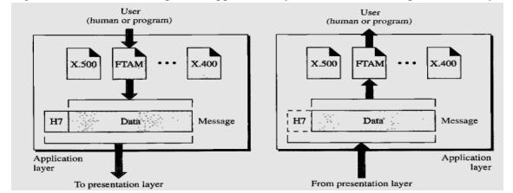
Application Layer

Slide 104
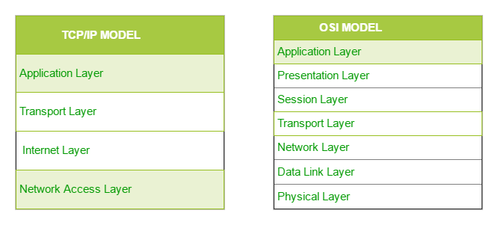
1.7 The TCP/IP Protocol Suite
●
TCP/IP stands for Transmission Control Protocol/Internet Protocol.
It was developed in 1970s.
It contains four layers, unlike seven layers in the OSI model. The layers are:
●
●
– Application Layer Transport Layer Internet(Network) Layer Network Access Layer
–
–
–

Slide 105
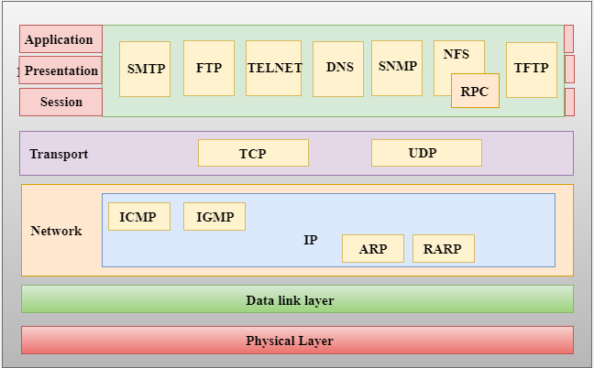
Figure: TCP/IP PROTOCOL SUITE (TCP/IP and OSI model)

Slide 106
4. Application Layer:
The application layer in TCP/IP is equivalent to the combined session, presentation, and application layers in the OSI model.
This layer uses a number of protocols, the main among which are as follows −
a. Hyper Text Transfer Protocol, (HTTP): It is used by the World Wide Web to manage communications between web browsers and servers. HTTPS stands for HTTP-Secure. It is a combination of HTTP with SSL(Secure Socket Layer).
b.File Transfer Protocol, (FTP): It is a standard internet protocol used for transmitting the files from one computer to another computer.
c. Simple Mail Transfer Protocol, (SMTP): It is used to send the data to another e-mail address.

Slide 107
Transport Layer:
Three Protocols of transport layer can be explained as:
a. User Datagram Protocol:
The User Datagram Protocol (UDP) is the simpler transport protocols.
It is a process-to-process protocol that adds only port addresses, checksum error control, and length information to the data from the upper layer.

Slide 108
Transport Layer:
b. The Transmission Control Protocol
TCP is a reliable stream transport protocol.
The term stream, in this context, means connection-oriented i.e; a connection must be established between both ends of a transmission before either can transmit data.
At the sending end of each transmission, TCP divides a stream of data into smaller units called segments.
Each segment includes a sequence number for reordering after receipt, together with an acknowledgment number for the segments received.
At the receiving end, TCP collects each segment as it comes in and reorders the transmission based on sequence numbers.

Slide 109
Transport layer
c. Stream Control Transmission Protocol:
It is a transport layer protocol that combines the best features of UDP and TCP.

Slide 110
2. Network Layer:
This layer parallels the functions of OSI’s Network layer. It defines the protocols which are responsible for logical transmission of data over the entire network. The main protocols residing at this layer are :
Internet Protocol (IP): This protocol implements logical host addresses known as IP addresses. The IP addresses are used by the internet to identify the device. IP has 2 versions: IPv4 and IPv6.
Address Resolution Protocol (ARP): It is a network layer protocol which is used to find the physical address from the IP address.
Internet Control Message Protocol (ICMP): is mainly used to determine whether or not data is reaching its intended destination in a timely manner.

Slide 111
1. Network Access Layer:
A network layer is the lowest layer of the TCP/IP model.
A network layer is the combination of the Physical layer and Data Link layer defined in the OSI reference model.
It defines how the data should be sent physically through the network.
This layer is mainly responsible for the transmission of data between two devices.
The functions carried out by this layer are encapsulating the IP datagram into frames and mapping IP addresses into physical addresses.
The protocols used by this layer are Ethernet, token ring, X.25, and frame relay.

Slide 112
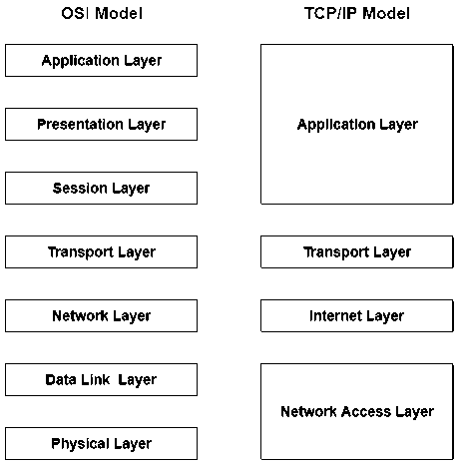
1.8 Comparison between OSI and TCP/IP Reference model
Following are some similarities between OSI Reference Model and TCP/IP Reference Model:
Both have layered architecture. Layers provide similar functionalities. Both are protocol stack.
●
●
●

Slide 113
Key Differences Between TCP/IP and OSI Model
TCP/IP is Transmission Control Protocol/ Internet Protocol while OSI is Open System Interconnection.
TCP/IP is a client server model used for transmission of data over the internet while OSI is a theoretical model which is used for computing system.
TCP/IP is a four-layered model, whereas, OSI has seven layers.
TCP/IP was developed by Department of Defense (DoD) while OSI was developed by ISO (International Standard Organization).
TCP/IP is mostly used while OSI was never used.
TCP/IP is a standard protocol used for every network including the Internet, whereas, OSI is not a protocol but a reference model used for understanding and designing the system architecture.
TCP/IP does not have a separate Presentation layer or Session layer whereas OSI does have separate Presentation and Session layer.
●
●
●
●
●
●

Slide 114
1.9 Critiques of OSI and TCP/IP Reference model
●
Bad timing
OSI model was finished and completed after huge and significant amount of research time.
TCP/IP model was already receiving huge amounts of investments from companies and manufacturers did not feel like investing in OSI model.
◆
●
Bad technology
OSI model and its protocols are flawed that means both of them have fundamental weakness in performance or design, etc.
Documentation of OSI is also highly complex due to which it gets very difficult to implement.
◆
●

Slide 115
Bad implementations
●
Initial implementations of OSI were very slow & huge.
Implementations of TCP/IP were more reliable than OSI due to which people started using TCP/IP very quickly which led to large community of users.
●
Bad politics
OSI model was not associated with UNIX.
TCP/IP was largely and closely associated with Unix.

Slide 116
Assignment 1
Define computer network. Explain network as an infrastructure for data communication with examples.
Explain different applications of computer networks in detail (e.g., business, communication, education, e-commerce).
What is network architecture? Explain different types of network architecture (Client-Server and Peer-to-Peer).
Explain different types of computer networks (LAN, MAN, WAN, PAN) with examples and diagrams.
Explain the OSI Reference Model with functions of all seven layers.
Describe the TCP/IP Protocol Suite and explain its layers and functions.
Discuss the criticisms (limitations) of the OSI reference model. Why is it not widely implemented?
Explain the drawbacks or criticisms of the TCP/IP model. Compare its limitations with OSI model.

